Slide 1
Transcription Start Site Annotation
ML Pipeline construction
Group 4: Ashita Jawali, Sofia Lima, Sanat Mishra, Parker Simpson

Slide 2
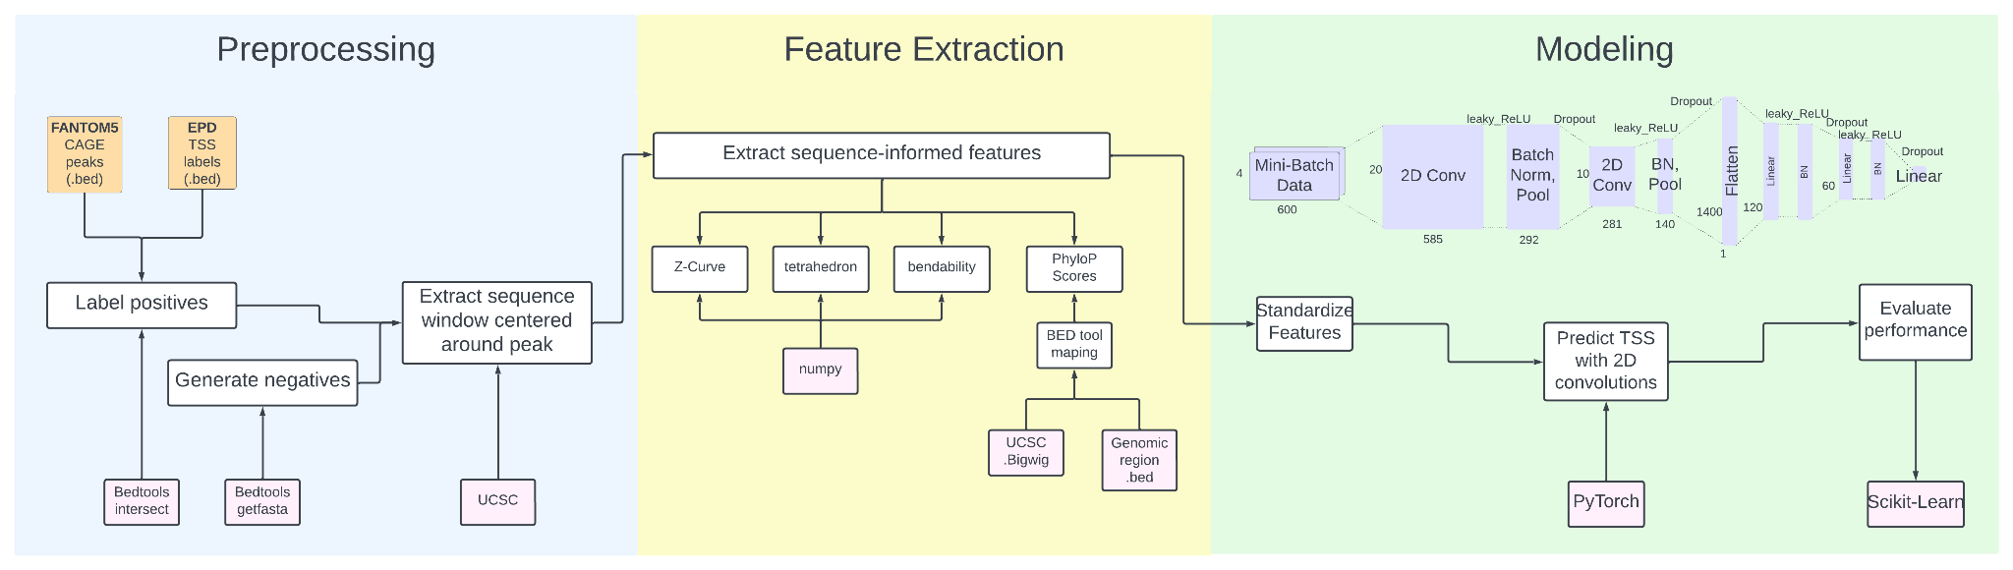
Pipeline Overview
Modeling Goal: Binary TSS prediction of 600bp input
Biological Goal: Train on human CAGE-peak windows and test on mouse

Slide 3
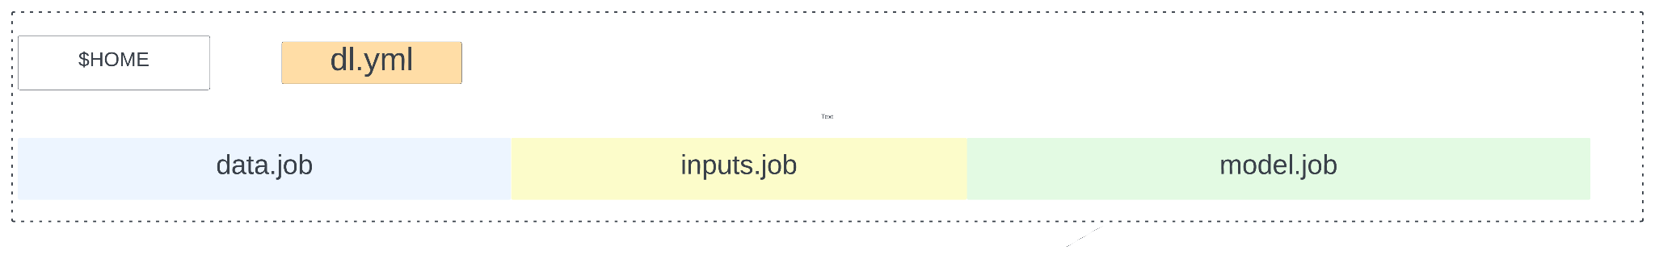
Example launch
Three job scripts and a .yml file

Slide 4
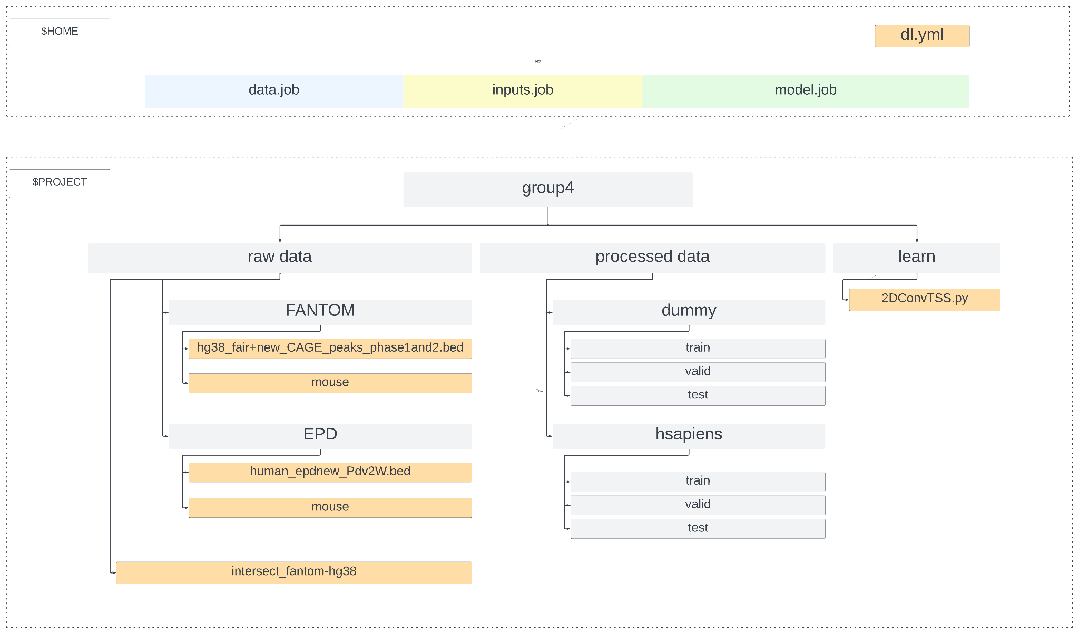
Example launch
Current Directory Structure

Slide 5
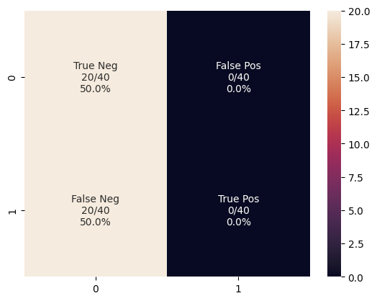
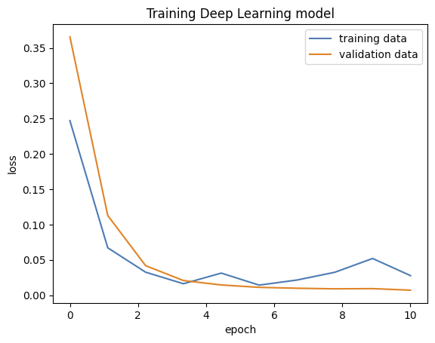
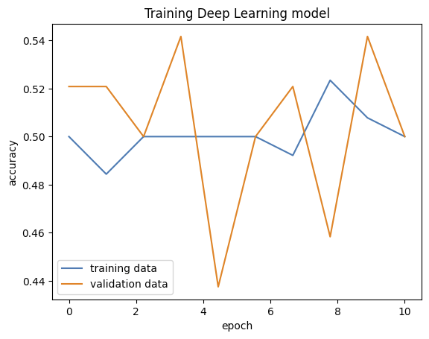
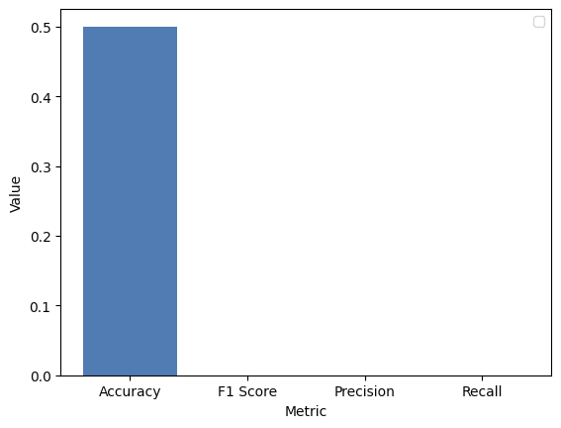
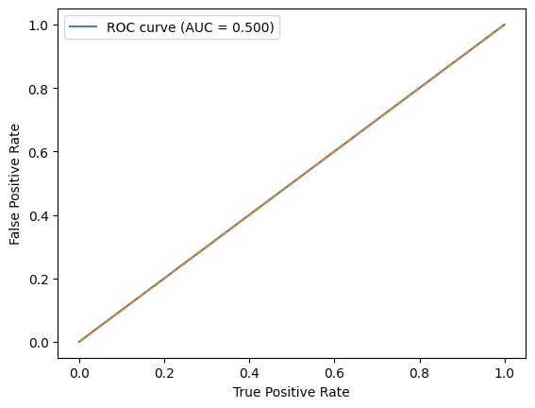
Results on dummy data
Training
Testing

Slide 6
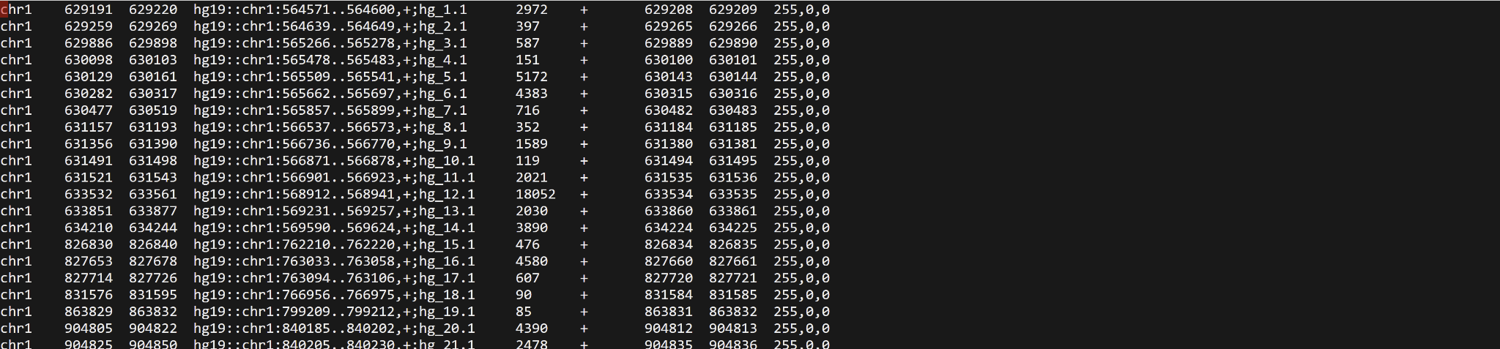
Remaining objectives
Test on mouse
Incorporate peak score in FANTOM data

Slide 7
Thank you!

